Slide 1

Object Oriented Software Engineering
Lecture 8

Slide 2
Today’s Outline:
Building Analysis Model:
Requirement Analysis
Data modelling Concepts
Flow Oriented Modelling

Slide 3
Building the Analysis Model
What is it?
The analysis model, actually a set of models, is the first technical representation of a system. The written word is a wonderful vehicle for communication, but it is not necessarily the best way to represent the requirements for computer software.
Analysis Modeling uses a combination of text and diagrammatic forms to depict requirements for data, function, and behavior in a way that is relatively easy to understand, straightforward to review for correctness, completeness, and consistency.

Slide 4
Building the Analysis Model
Who does it?
A software engineer ( called as analyst) builds the model using requirements elicited from the customer.
Why is it important?
To validate software requirement, you need to examine them from a number of different points of view. Analysis modeling represents requirements in multiple ‘dimensions’.

Slide 5
Building the Analysis Model
What is the work product?
A wide array of diagrammatic forms may be chosen for the analysis model. Each of these representations provides a view of one or more of the model elements.

Slide 6
Overview of Analysis Modeling
At a technical level, SE begins with a building an analysis
model of a target system.
Requirements analysis
species software's operational characteristics
indicates software's interface with other system elements
establishes constraints that software must meet
Objectives
1 to describe what the customer requires
2 establish a basis for the creation of a SW design
3 to define requirements that validated a set of can be once
the software is built

Slide 7
Analysis Modeling
Requirements analysis allows the software engineer to:
elaborate on basic requirements established during earlier
requirement engineering tasks
build models that depict
- user scenarios
- functional activities
- problem classes and their relationships
- system and class behavior
- flow of the data as it is transformed

Slide 8
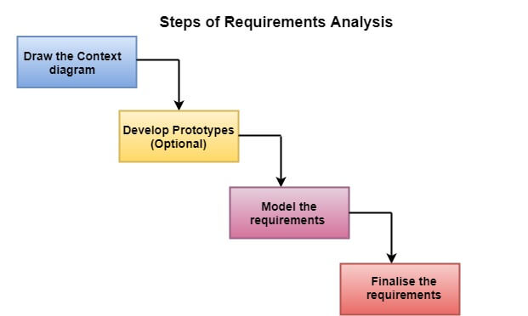
Steps of Requirements Analysis

Slide 9
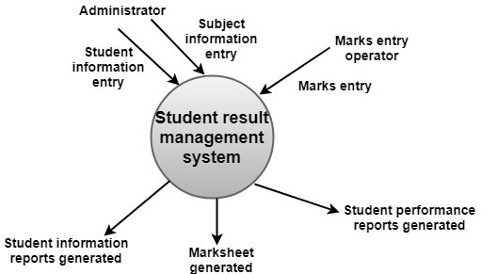
Steps of Requirements Analysis
(i) Draw the context diagram: The context diagram is a simple model that defines the boundaries and interfaces of the proposed systems with the external world. It identifies the entities outside the proposed system that interact with the system.

Slide 10
Steps of Requirements Analysis
(ii) Development of a Prototype (optional): One effective way to find out what the customer wants is to construct a prototype, something that looks and preferably acts as part of the system they say they want. We can use their feedback to modify the prototype until the customer is satisfied continuously.
(iii) Model the requirements: This process usually consists of various graphical representations of the functions, data entities, external entities, and the relationships between them. The graphical view may help to find incorrect, inconsistent, missing, and superfluous requirements. Such models include the Data Flow diagram, Entity-Relationship diagram, Data Dictionaries, State-transition diagrams, etc.

Slide 11
Steps of Requirements Analysis
(iv) Finalize the requirements: After modeling the requirements, we will have a better understanding of the system behavior. The inconsistencies and ambiguities have been identified and corrected. The flow of data amongst various modules has been analyzed. Elicitation and analyze activities have provided better insight into the system. Now we finalize the analyzed requirements, and the next step is to document these requirements in a prescribed format.

Slide 12
Requirement Analysis
The analysis model as a bridge b/w the system description and the design model
System Description
Analysis Model
Design Model
Describe the system functionality

Slide 13
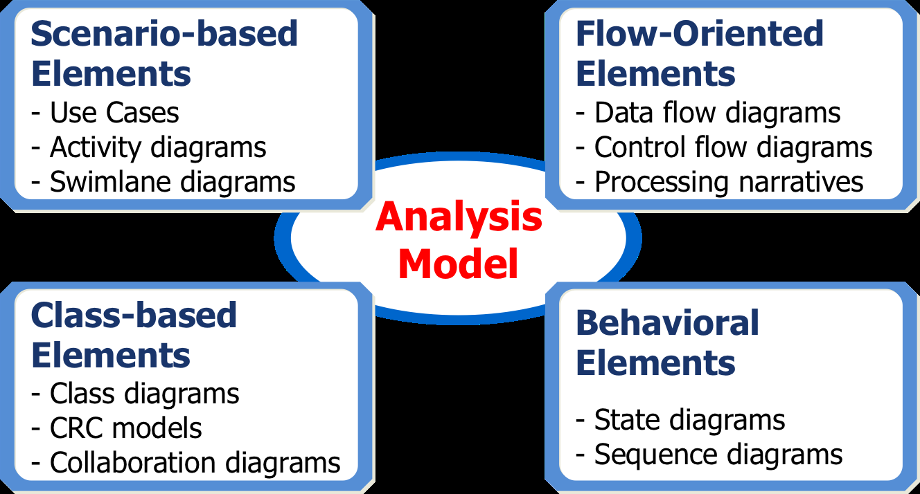
Elements of Analysis Model

Slide 14
Scenario-Based Modeling
Use-cases are amply an aid to defining what exists outside
the system (actors) and what should be performed by the
system (use-cases)
1 How should we write about?
2 How much should we write about?
3 How detailed should we make our description?
4 How should we organize the description?

Slide 15
Scenario-Based Modeling
Activity Diagram
Supplements the use-case by providing a diagrammatic
representation of procedural flow
- used as business modeling notation along with Business
Process Modeling Notation
Swimlane Diagrams
Allows the modeler to represent the flow of activities described by the use-case
This diagram indicates which actor or analysis class has
responsibility for the action described by an activity rectangle

Slide 16
Class-based Modeling
Class-based modeling represents:
objects that the system will manipulate
operations (methods or services) that will be applied to the
objects to effect the manipulation
relationships (some hierarchical) between the objects
collaborations that occur between the classes that are defined
The elements of a class-based model
classes, objects, attributes, operations
CRC models
collaboration diagrams and packages

Slide 17
Class-based Modeling
Class-Responsibility-Collaborator (CRC) Modeling
Analysis classes have \responsibilities"
Responsibilities are the attributes and operations encapsulated by the class
Analysis classes collaborate with one another
a property transfer or the completion of a series of robot
movements
Collaborators are those classes that are required to provide a
class with the information needed to complete a responsibility
In general, a collaboration implies either a request for
information or a request for some action

Slide 18
Behavioral Modeling
Behavioral model indicates how software will respond to
external events.
Behavioral model creation steps:
evaluate all use-cases to fully understand the sequence of interaction within the system
identify events that drive the interaction sequence and
understand how these events relate to specfic objects
Create a sequence for each use-case
Build a state diagram for the system
Review the behavioral model to verify accuracy and consistency

Slide 19
Flow-Oriented Modeling
The flow model, at its base, is a simple graphical representation of how information and artifacts flow through the system as it is used. ... A flow model gives you an overview of how information, artifacts, and work products flow among user work roles and parts of the product or system as the result of user actions.
It shows how data objects are transformed by processing the function.
Represents how data objects are transformed as they move through the system

Slide 20
Rules of Thumb
1 The model should focus on requirements that are visible within the problem or business domain
the level of abstraction should be relatively high
2 Each element of the analysis model should
add to an overall understanding of software requirements
provide insight into the
- information domain
- function of the system
- behavior of the system
3 Delay consideration of infrastructure and other non-functional models until design
4 Minimize coupling throughout the system
5 Be certain that the analysis model provides value to all stakeholders
6 Keep the model as simple as it can be

Slide 21
Domain Analysis
Software Domain Analysis (Structured Analysis)
the identification, analysis, and specification of common requirements from a specific application domain, typically for reuse on multiple projects within that application domain ...
Object-Oriented Domain Analysis
the identification, analysis, and specification of common, reusable capabilities within a specific application domain, in terms of common objects, classes, subassemblies, and frameworks . . .
by Donald Firesmith
Define the domain to be investigated
Collect a representative sample of applications in the domain
Analyze each application in the sample
Develop an analysis model for the objects.

Slide 22
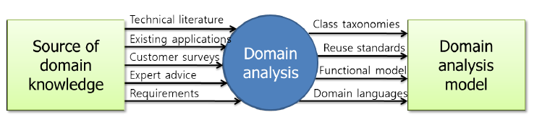
Domain Analysis

Slide 23
Data Modeling Concepts
Analysis modeling often begins with data modeling. Analyst defines all data, objects that are processed within the systems, the relationships between the data objects, and other information that is pertinent to the relationships.

Slide 24
Data Modeling
Analysis modeling often begins with data modeling
examines data objects independently of processing
focuses attention on the data domain
Indicates how data objects relate to one another
Relationship among data objects can be expressed in UML very well.
Typical data objects
External entities: printer, user, sensor
Things: reports, displays, signals
Occurrences or events: interrupt, alarm
Roles: manager, engineer, salesperson
Organizational units: division, team
Places: manufacturing floor
Structure: employee record

Slide 25

Data Modeling
Data objects, data attributes, relationships
Data objects are the representation of composite information that are process by software
A data object encapsulates data only
Entity Relationship Diagram (ER Diagram)

Slide 26
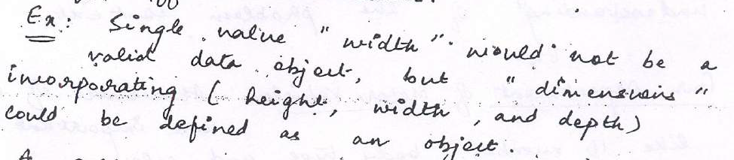
Data Modeling Concepts
A. Data Objects:
A data objects is a representation of almost any composite information i.e. something that has a number of different attributes.

Slide 27
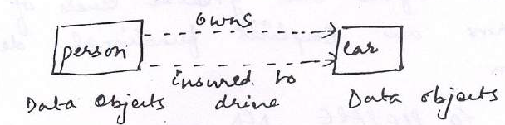
Data Modeling Concepts
Relationships:
Data objects are connected to one another in different ways.
Consider the two data objects person and car.
A person owns a car
A person is insured to drive a car.

Slide 28
Data Modeling Concepts
Cardinality and Modality:
Suppose object X relates to object Y does not provide enough information for software engineering purposes.
We must understand how many occurrences of object X are related to how many occurrences object Y. This leads to data modeling concept called “cardinality”.
Example:
1:1, n:n etc.

Slide 29
Data Modeling Concepts
The modality of a relationship is 0 (Zero) if there is no explicit need for the relationship to occur or the relationship is optional. The modality is 1 (one) if an occurrence of the relationship is mandatory.

Slide 30
Flow Oriented Modeling
The flow oriented modeling represents how data objects are transformed at they move through the system. Derived from structured analysis, flow models use the data flow diagram, a modeling notation that depicts how input is transformed into output as data objects move through the system. Each software function that transforms data is described by a process specification or narrative. In addition to data flow, this modeling element also depicts control flow.

Slide 31
Flow Oriented Modeling
Although flow oriented modeling is perceived as an outdated technique by some software engineers, it continues to be one of the most widely used requirements analysis notations in use today. Flow oriented modeling focuses on structured analysis and design, follows a top to down methodology and uses a graphical technique depicting information flows and the transformations that are applied as data moves from input to output.

Slide 32
Flow Oriented Modeling
The modeling tools that are used to build a data flow oriented model include context diagrams, data flow diagrams, entity relationship diagram, control flow diagram, state transition diagram, data dictionary, process specification and control specification. Although the data flow diagram (DFD) and related diagrams and information are not a formal part of UML (Unified Modeling Language), they can be used to complement UML diagrams and provide additional insight into system requirements and flow. The flow oriented modeling takes an input-process-output view of a system. That is, data objects flow into the software, are transformed by processing elements, and resultant data objects flow out of the software.

Slide 33
Data Flow Diagram :
The data flow diagram represents the flows of data between different process in a business. It is a graphical technique that depicts information flow and transforms that are applied as data from input to output. It provides a simple, intuitive method for describing business processes without focusing on the details of computer systems. DFDs are attractive techniques because they provide what users do rather than what computers do. In DFD, there are four symbols are used :

Slide 34


Data Flow Diagram :
1. Process :
The circle represents the process. An activity
that changes or transforms data flows. Since
they transform incoming data to outgoing data, all processes must have inputs and outputs on a DFD.
2. Data Flow : The labeled arrows indicate incoming and outgoing data flow. Movement of data between external entities, processes and data stores is represented with an arrow symbol, which indicates the direction of flow.

Slide 35


Data Flow Diagram :
3. Data Store :
The rectangle represents an external
entity. A data store does not generate any operations but simply holds data for later access.
4. External Entity :
In Data Flow Diagrams external entities produce and consume data that flows between the entity and the system being diagrammed.

Slide 36
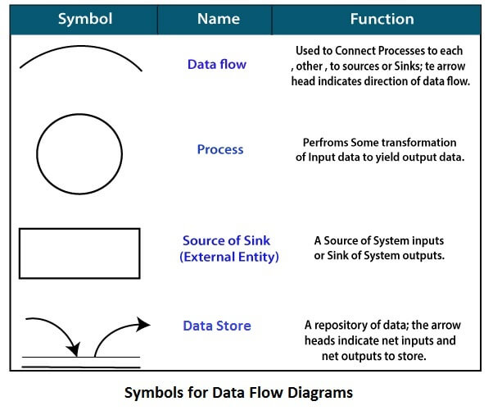
Data Flow Diagram
Circle: A circle (bubble) shows a process that transforms data inputs into data outputs.
Data Flow: A curved line shows the flow of data into or out of a process or data store.
Data Store: A set of parallel lines shows a place for the collection of data items. A data store indicates that the data is stored which can be used at a later stage or by the other processes in a different order. The data store can have an element or group of elements.
Source or Sink: Source or Sink is an external entity and acts as a source of system inputs or sink of system outputs.

Slide 37
Data Flow Diagram :
These data flows are the inputs and outputs of the DFD. Data objects are represented by labeled arrows, and transformations are represented by circles. The DFD is presented in a hierarchical fashion. That is, the first data flow model (sometimes called a level 0 DFD or context diagram) represents the system as a whole. Subsequent data flow diagrams refine the context diagram, providing increasing detail with each subsequent level.
In DFD there are various levels of DFD, which provide details about the input, processes, and output of a system. Note that the level of detail of process increases with increase in level(s). However, these levels do not describe the system's internal structure or behavior. These levels are listed next :

Slide 38
Data Flow Diagram :
1. Level 0 DFD : This shows an overall view of the system. Level a DFD is also known as context diagram. 2. Level 1 DFD : This elaborates level a DFD and splits the process into a detailed form.
3. Level 2 DFD : This elaborates level 1 DFD and displays the process(s) in a detailed form. 4. Level 3 DFD : This elaborates level 2 DFD and displays the process(s) in a detailed form.

Slide 39
Creating a Data Flow model :
The data flow diagram enables us to develop models of the information domain and functional domain. As the DFD is refined into greater levels of detail, you perform an implicit functional decomposition of the system. The Simple guidelines the derivation of a data flow diagram :- 1. All icons must be labeled with meaningful names. 2. The DFD evolves through a number of levels of details. 3. Always begin with a context level diagram (also called level 0).
4. Always show external entities at level 0 and 1. 5. The level 0 data flow diagram should depict the software/system as a single bubble.

Slide 40
Creating a Data Flow model :
6. Primary input and output should be carefully noted. 7. Refinement should begin by isolating candidate processes, data objects, and data stores to be represented at the next level. 8. All arrows and bubbles should be labeled with meaningful names. 9. Information flow continuity must be maintained from level to level. 10. One bubble at a time should be refined.

Slide 41
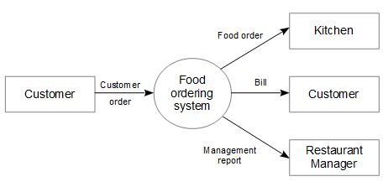
Example of Data Flow Diagram :
The below figure shows the level 0 DFD diagram of food ordering system in restaurant.
Here customer, kitchen and restaurant managers are external entities.
The "food ordering system" accepts the food order from the customer and forwards the order to the kitchen.
When the service is provided to the customer, the system generates the bill.
A copy of customer bill can be submitted to the manager as a part of restaurant management report.
Figure : Level 0 DFD for "food ordering system" in restaurant

Slide 42
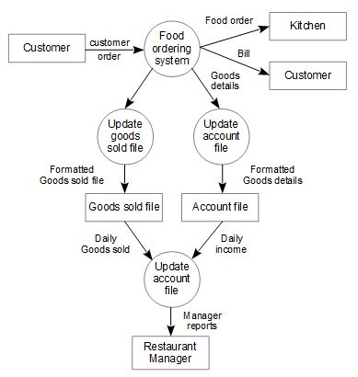
Example of Data Flow Diagram :
This level 0 DFD can be extended to level 1 DFD to show more details showing exact data flow and processes.

Slide 43
Data Flow Diagram
The following observations about DFDs are essential:
All names should be unique. This makes it easier to refer to elements in the DFD.
Remember that DFD is not a flow chart. Arrows is a flow chart that represents the order of events; arrows in DFD represents flowing data. A DFD does not involve any order of events.
Suppress logical decisions. If we ever have the urge to draw a diamond-shaped box in a DFD, suppress that urge! A diamond-shaped box is used in flow charts to represents decision points with multiple exists paths of which the only one is taken. This implies an ordering of events, which makes no sense in a DFD.
Do not become bogged down with details. Defer error conditions and error handling until the end of the analysis.

Slide 44
Data Flow Diagram
Control Specifications
The Control Specifications (CSPEC) is used to indicate (1) how the software behaves when an event or control signal is sensed and (2) which processes are invoked as a consequence of the occurrence of the event. The control specification (CSPEC) contains a number of important modeling tools. The control specification represents the behavior of the system in two ways. The CSPEC contains a state transition diagram that is sequential specification of behavior. It also contains a process activation table (PAT) -a combinatorial specification of behavior.

Slide 45
Data Flow Diagram
Process Specifications
A process specification is a method used to document, analyze and explain the decision-making logic and formulas used to create output data from process input data. Its objective is to flow down and specify regulatory/engineering requirements and procedures. High-quality, consistent data requires clear and complete process specifications.

Slide 46
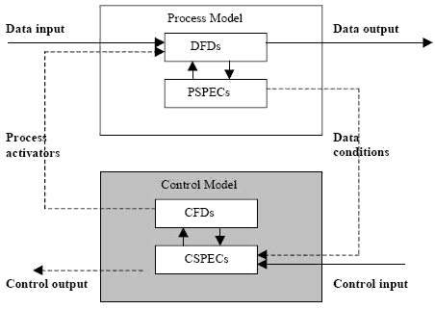
Data Flow Diagram

Slide 47
DFD Practice examples
Draw a context diagram of DFD for Supermarket App

Slide 48
Thank You

